Slide 1
HR Compensation Tool
How to hit the 1 Billion mark

Slide 2
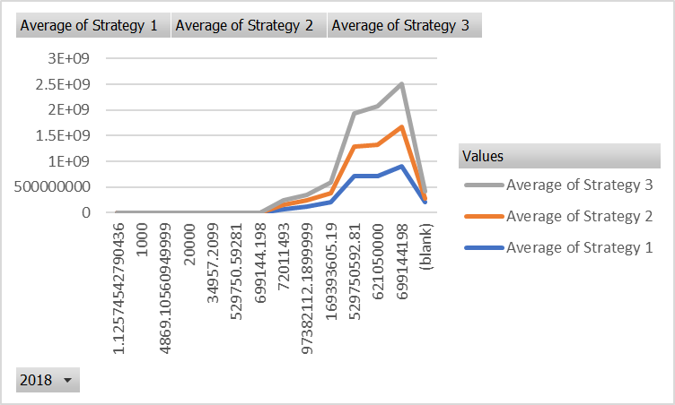
Comparing Strategies
Past Data

Slide 3
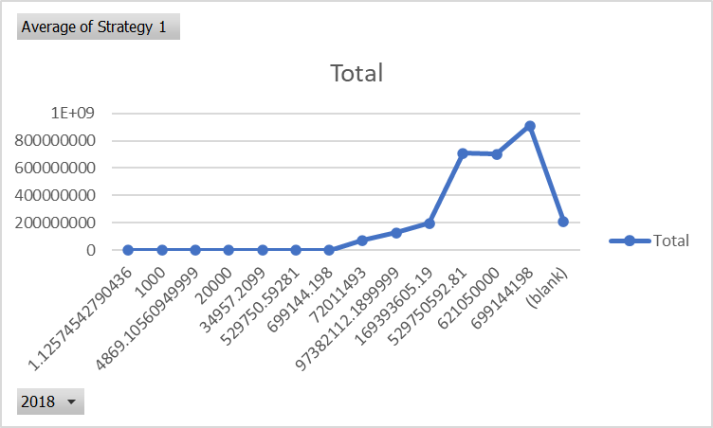
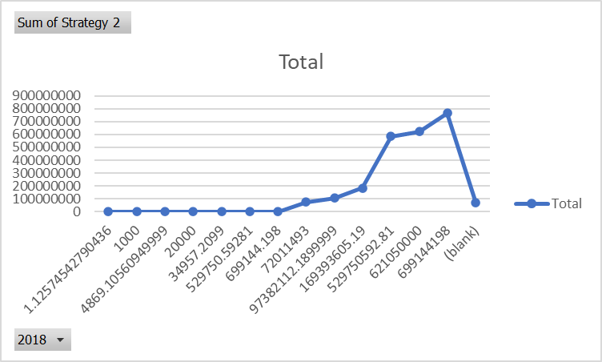
Each Strategy Individually
Study 1
Study 2
Study 3

Slide 4
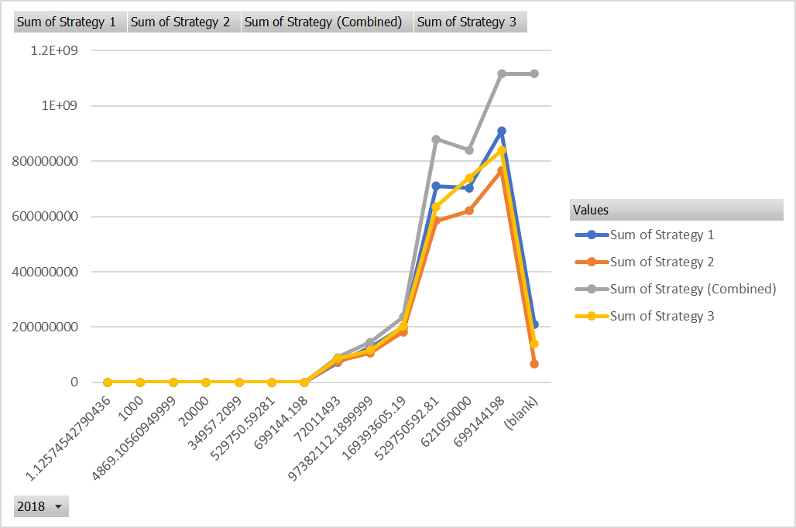
Combining Strategies
Past the Billion Mark

Slide 5
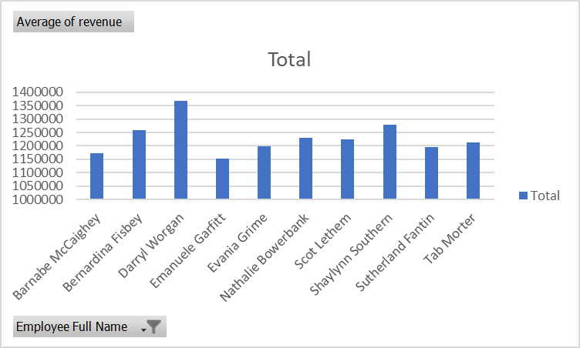
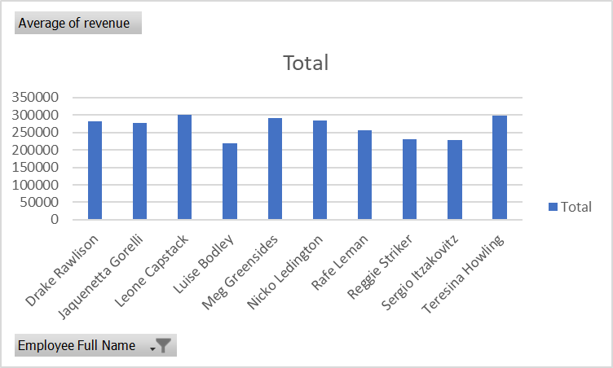
Improving average revenue
Top 10 earners
Bottom 10 earners

Slide 6
Conclusion
Hitting the mark should be a breeze

